Slide 1




How to register your action for EWWR 2026
in
steps

Slide 2
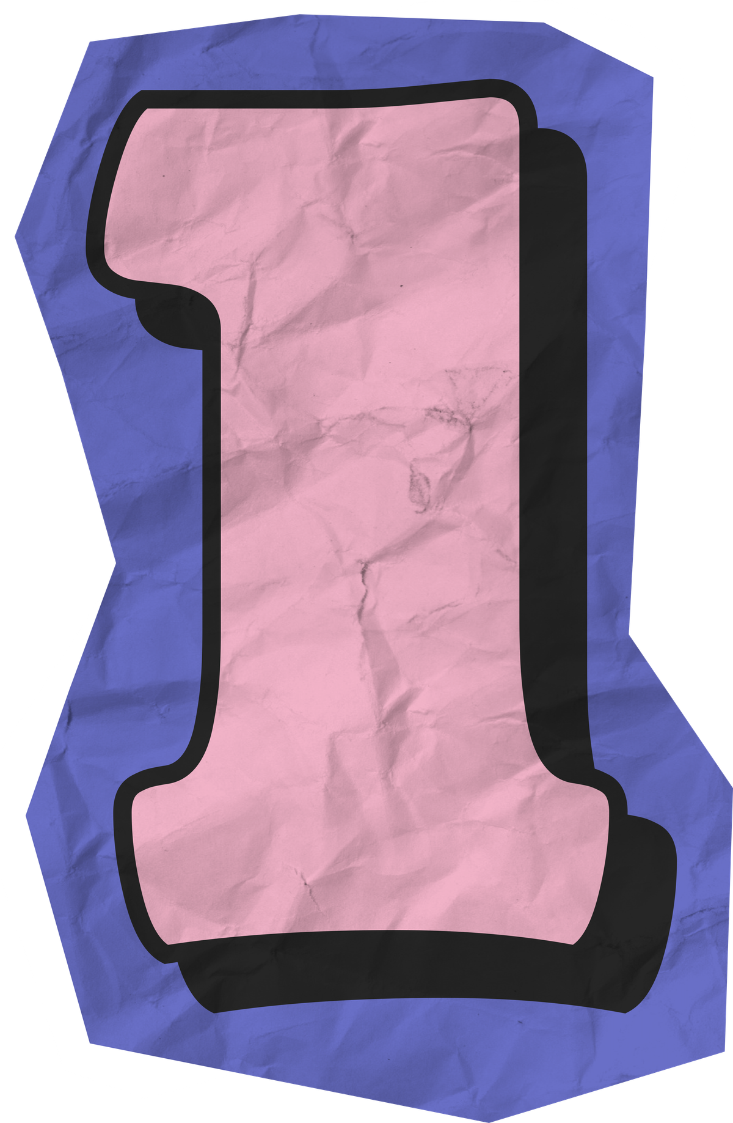
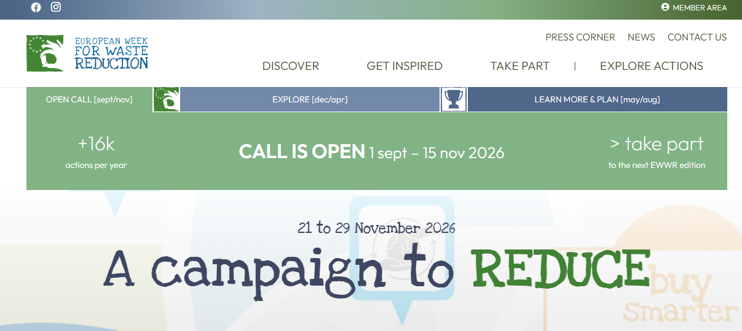
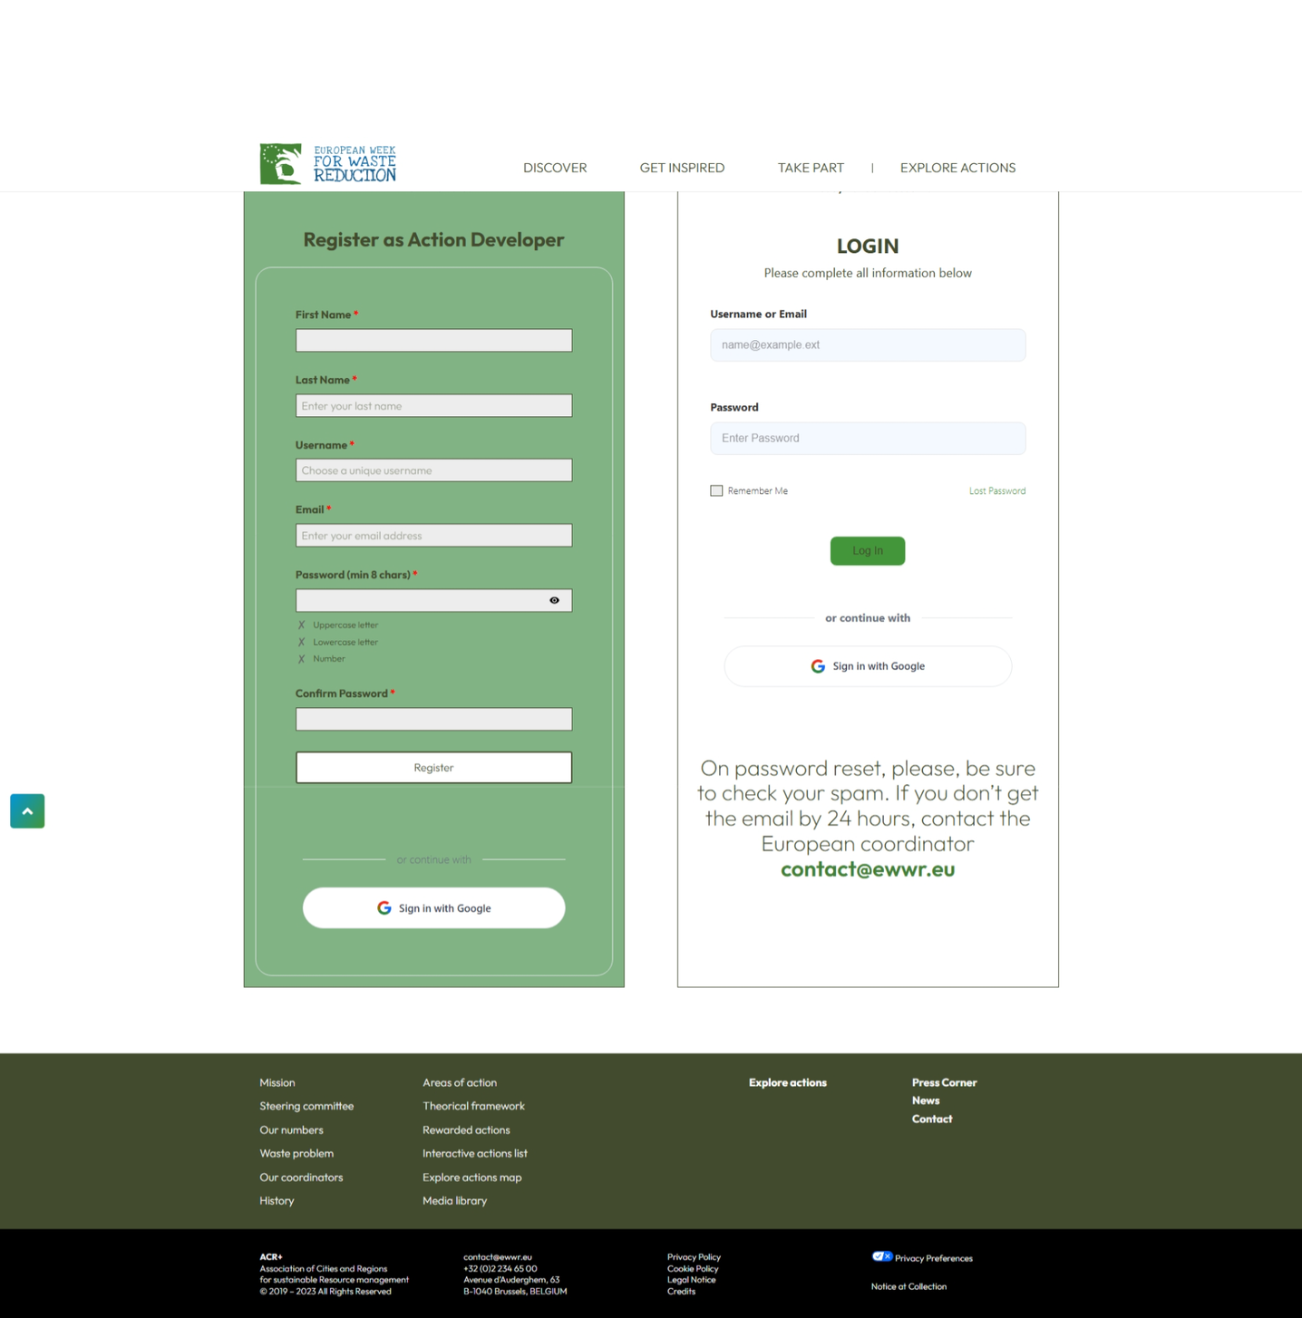
Go to your Member Area:
  Sign up if you’re new
  Log in if you already have a profile
First time here?
Already have an account?

Slide 3

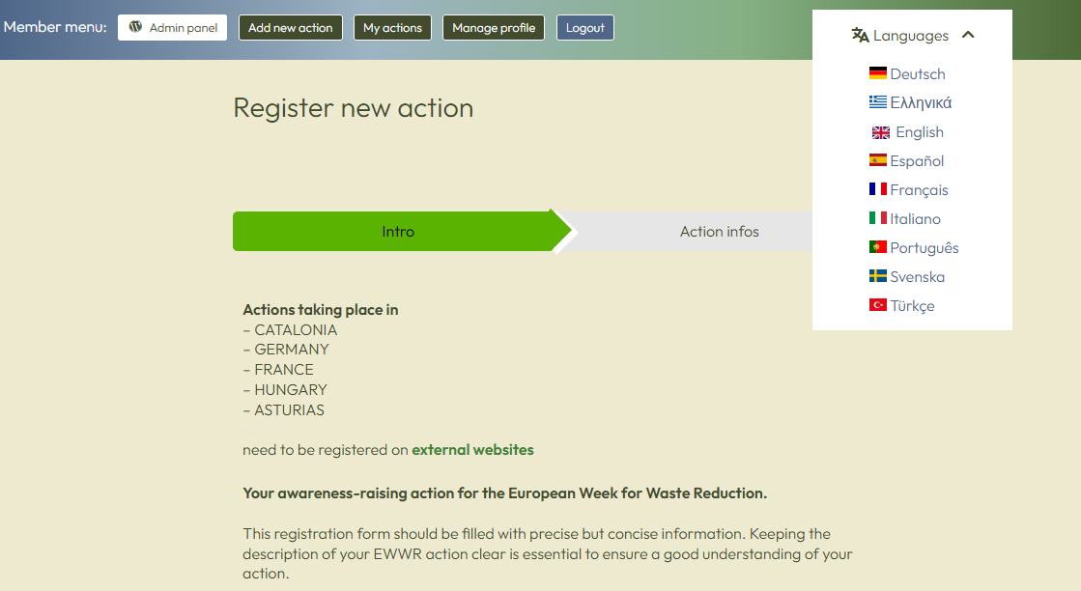
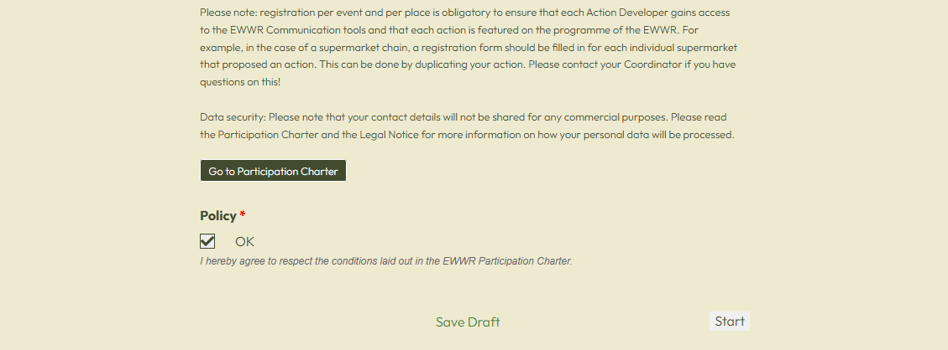
Before start:
  Select your language,
  read the Participation Charter,
  and agree to the terms and conditions.

Slide 4

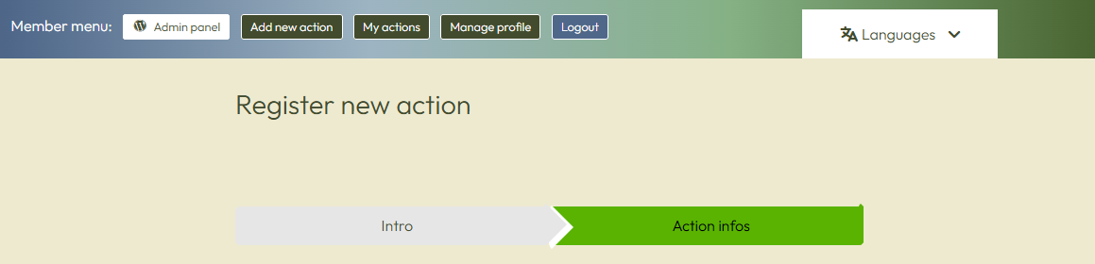
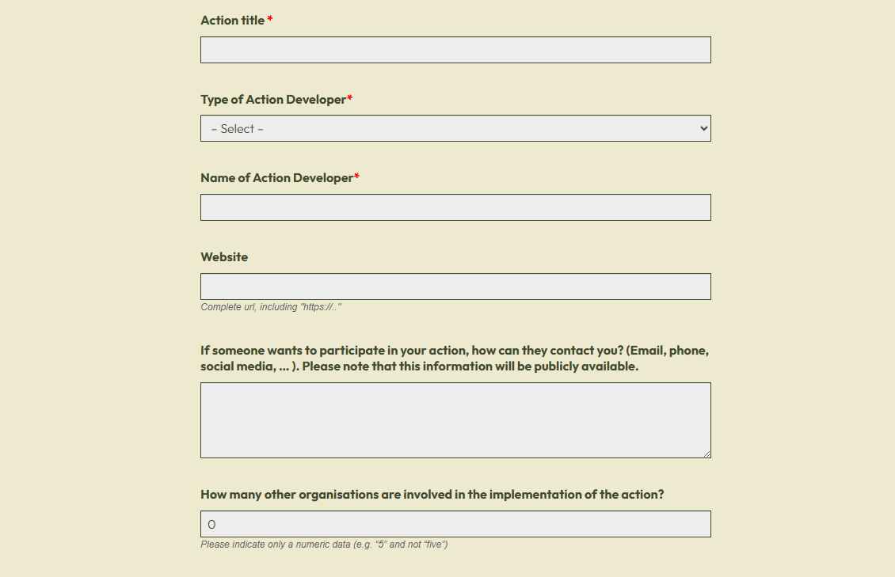
Fill in the information about your action:
  General information

Slide 5
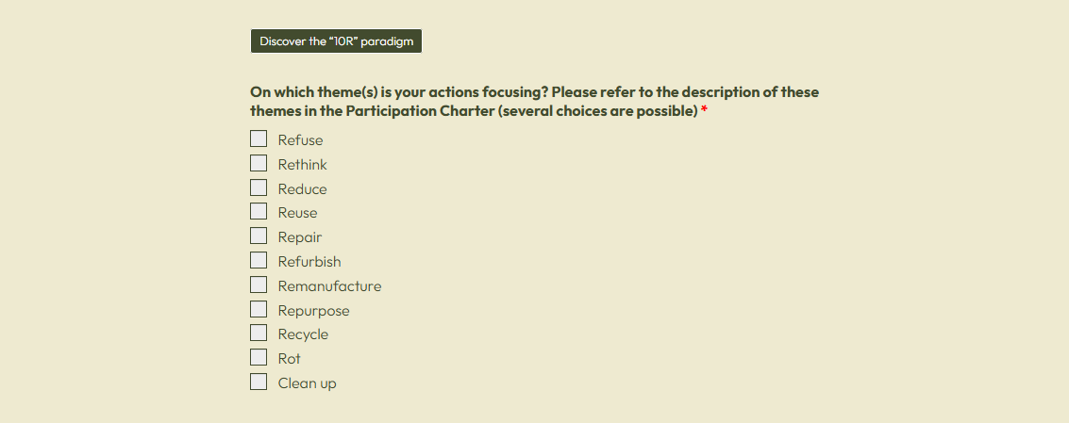
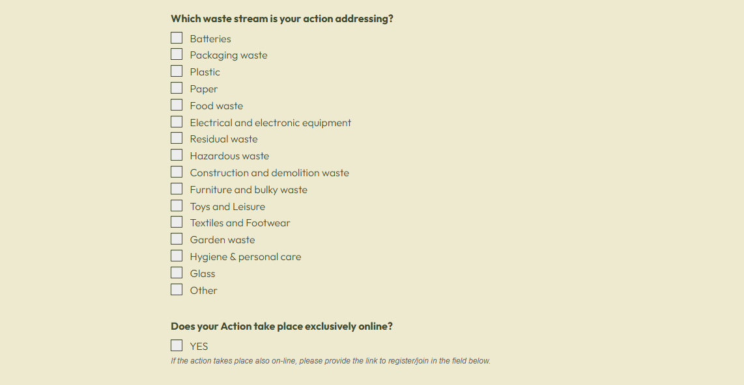
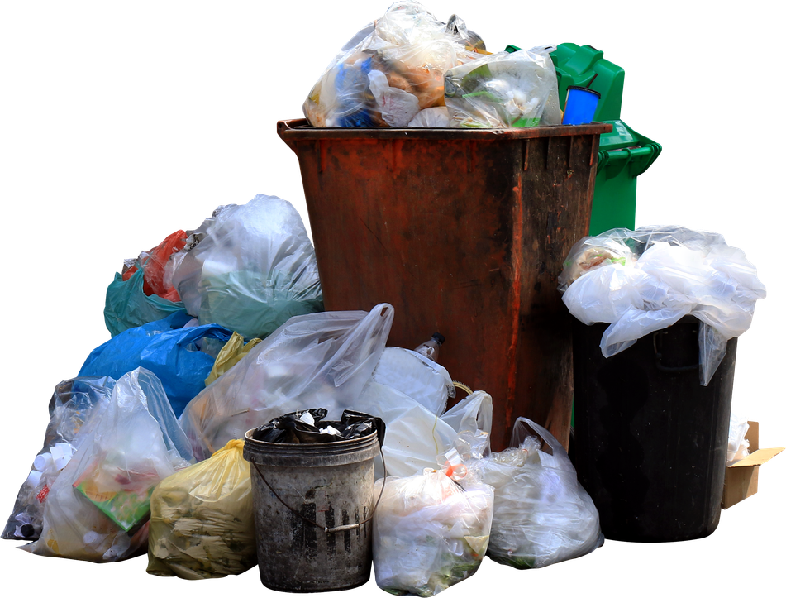
Fill in the information about your action:
  Which topics and waste streams does it address?

Slide 6
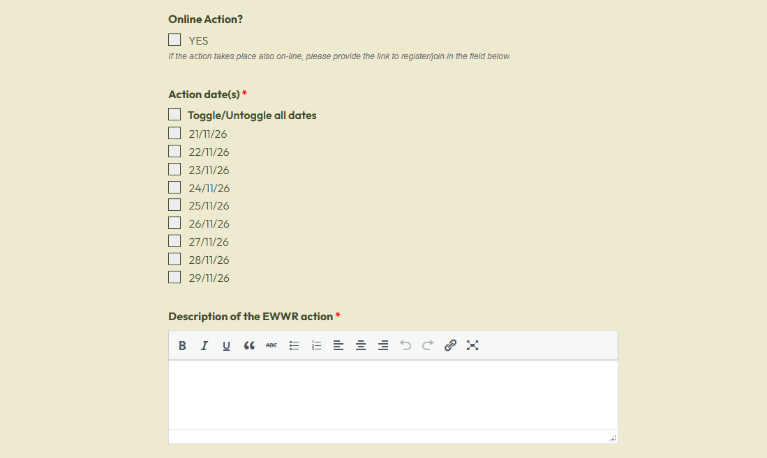
Fill in the information about your action:
  When
  All details
This is the space where you can elaborate and provide us with all the details about the action.

Slide 7
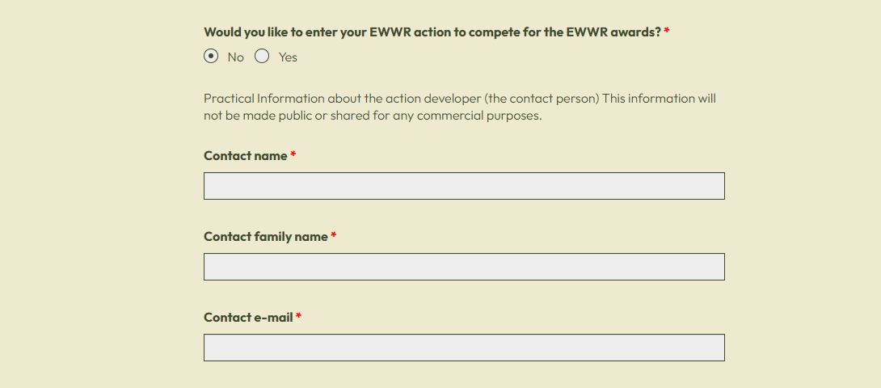
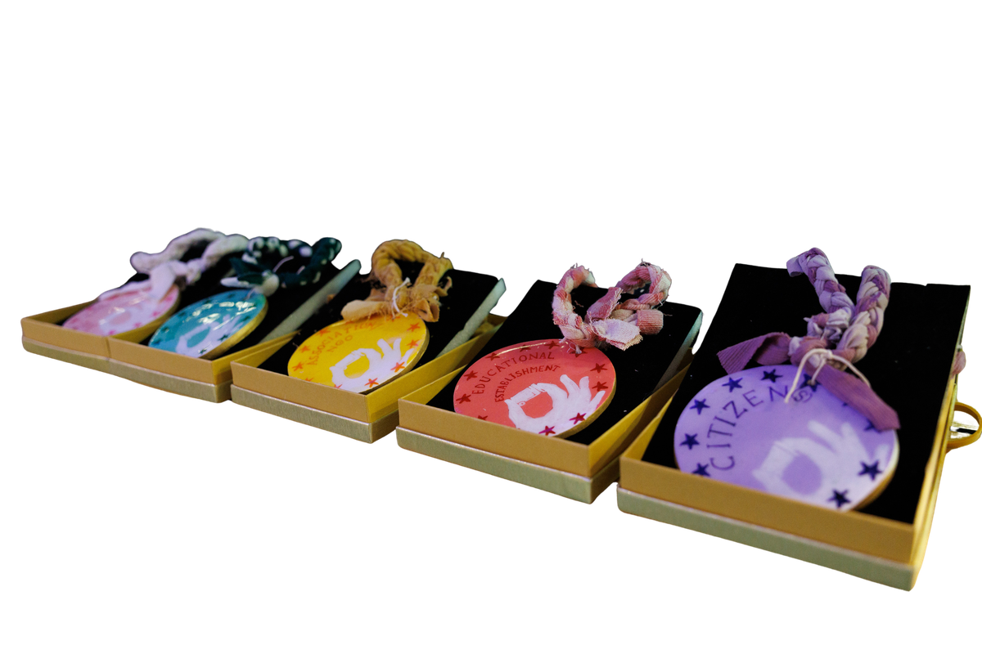
Fill in the information about your action:
  Interested in the EWWR Awards?

Slide 8
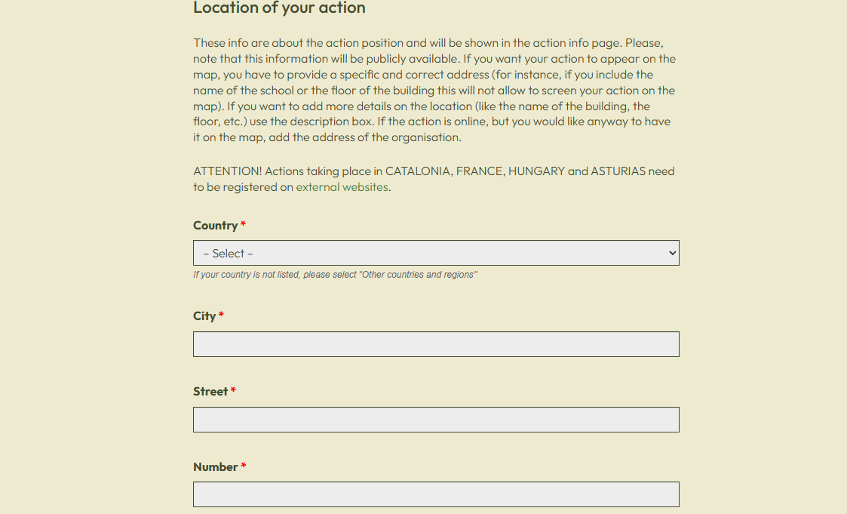
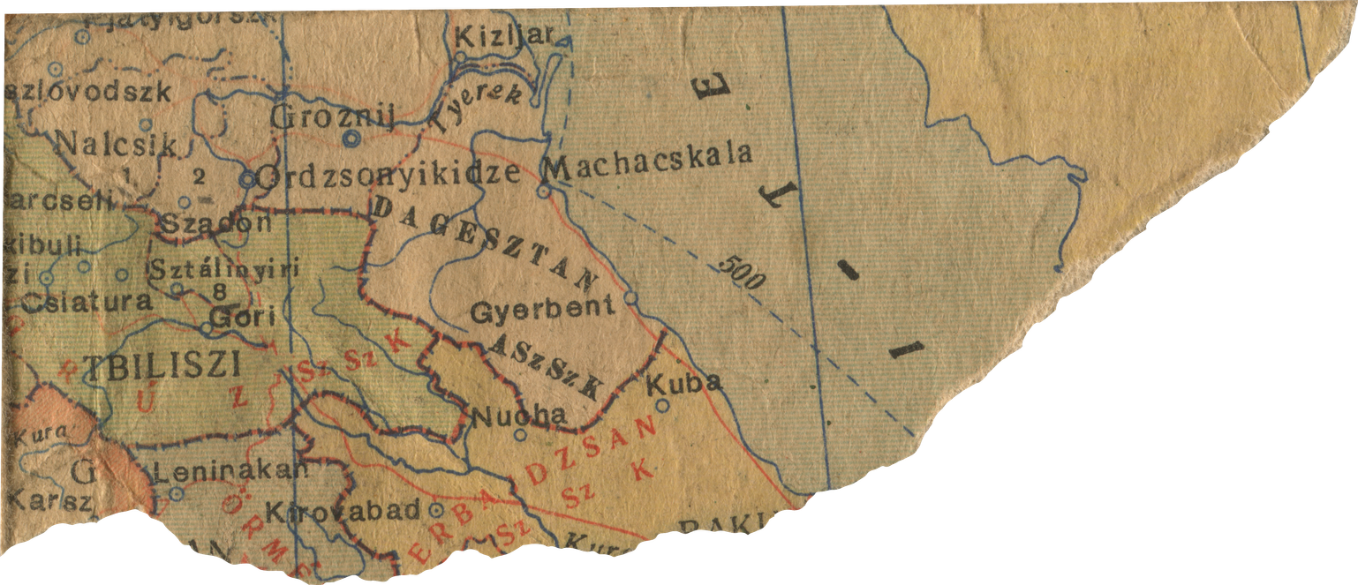
Fill in the information about your action:
  Location

Slide 9

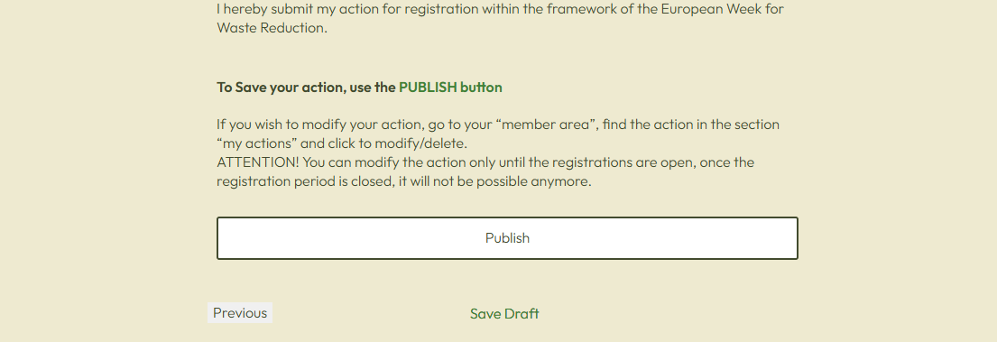

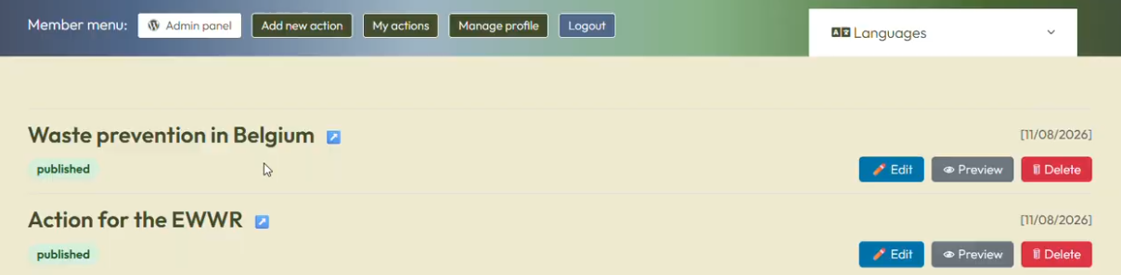
Publish your action
Don’t forget to publish it so that your action is submitted!
After being published, the actions can be modified until registration closes.

